Slide 1
Bringing real objects, spaces, actions, and interactions into social VR
MIT Media Lab, Cambridge, MA USA

Slide 2
INTRODUCTION
a novel multiuser virtual reality (VR) system where the physical world is used as a template for the placement of walls, furniture, and objects in the virtual world so as to create a correspondence in scale, spatial layout, and object placement between the two spaces
In this paper, they describe a approach to creating a VR system that allows users with full-body avatars to walk in the real/virtual spaces and interact with virtual objects through physical proxies

Slide 3
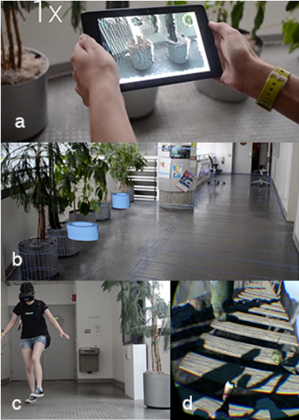
3D scanning real world space using the Google Tango device. A mesh is generated from the scanned point cloud data and used to create the virtual scene.
Using the mesh as a template, virtual objects like barrels and bridge (in blue) are created and placed in the same position and orientation as the real world planters and hallway.
User wearing Oculus Rift lifting up their left foot to start walking in the hallway
User seeing (first person view through the HMD) their avatar’s left foot lift up in sync with their real foot

Slide 4
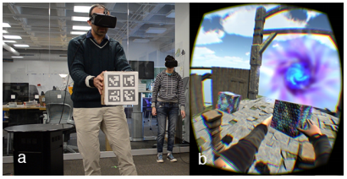
A user grasping a physical box while simultaneously grasping a virtual box
View through the user’s HMD showing their avatar grasping a virtual box. Both user’s have full-body avatars that they control through their body movements in the real world

Slide 5
SYSTEM
Start with a 3D reconstruction of the real world space where we plan to situate the virtual environment, using the Google Project Tango device and Voxxlr
Tango devices are equipped with integrated sensors that can measure the distance from a device to objects in the real world and provide the position and orientation of the device in six degrees of freedom, it is a self-contained device
Voxxlr -3D scanner for Tango APK

Slide 6
Texturing
use the position and size of walls, furniture, and objects as a guide for the placement of similar obstacles in the virtual world such that a correspondence between the two spaces exists
E.g.: an empty cardboard box feels light, non-slippery, a little rough, and has a distinct sound when touched or moved. Our virtual box therefore needs to match some of these tactile characteristics to maintain coherence in sensory feedback
Body and Object Tracking
used one or more Kinects to track users and objects
By tracking up to 25 joints representing body parts such as head, neck, shoulders, and arms the user is able to realistically control the avatar body by mapping the 3D coordinates of each joint to the corresponding bones in a rigged 3D model
This approach for interacting with physical objects builds on the concept of passive haptics , i.e. receiving feedback from touching a physical object that is registered to a virtual object

Slide 7
User Experience
To receive initial feedback, we deployed an initial prototype of our system in our lab space for few hours
A total of 34 participants tried our system, for approximately 8-10 minutes each with generally positive reactions
Most people appreciated being able to walk without fear of colliding with things and seeing a full body avatar instead of disembodied hands of their previous VR experiences
In the setup for the hallway/bridge scenario, two users start at opposite ends of the hallway/bridge and walk towards one another, they end with a high five in the real world which corresponds to a high five by their avatars in the virtual world
In the open space/floating island scenario, both users are tracked by a single Kinect placed in front of them and the RGB camera of the Kinect is used for tracking the boxes, Each user was then asked to walk up to the virtual box on the pillar a few feet in front of them, to pick it up and put it on top of the other box
Based on initial feedback from users, that physical movement, full-body avatar, and interaction with other people and objects helped create a natural and immersive VR experience.

